Slide 1
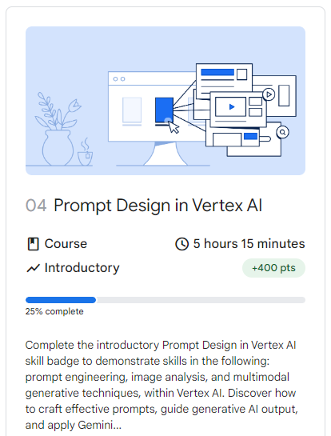

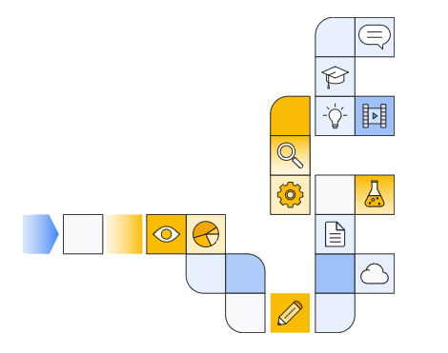

Notes:
https://www.cloudskillsboost.google/paths/118/course_templates/976

Slide 2
Getting into Google Cloud Console

Slide 3
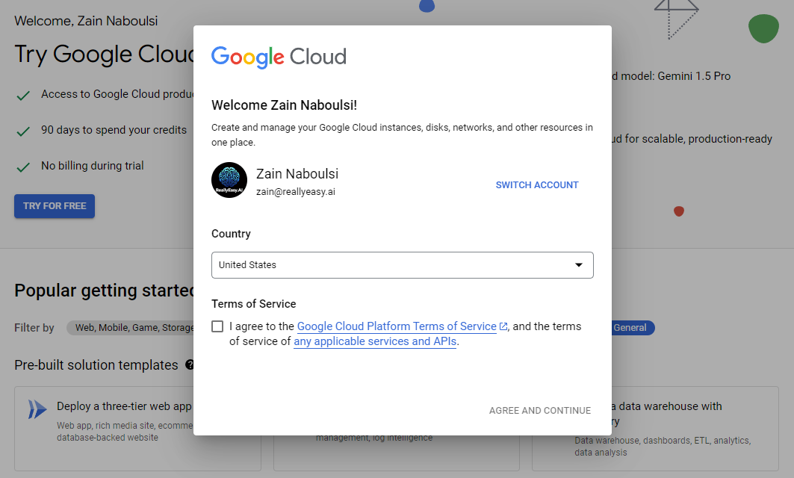

Slide 4
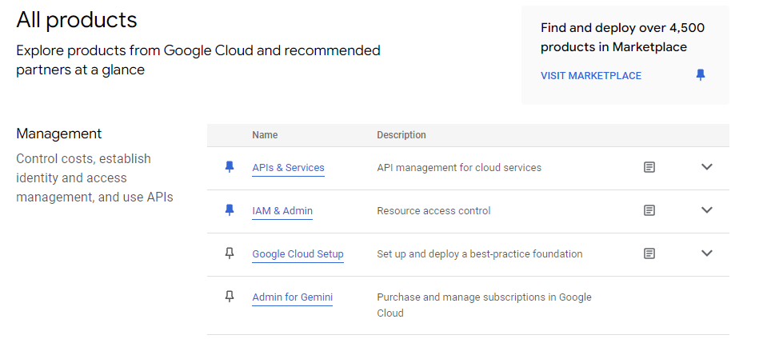
Picking Your Products

Slide 5
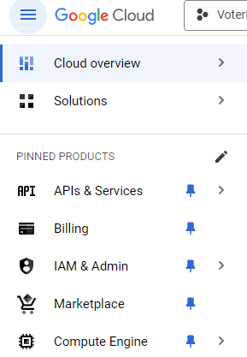
Organizing the sidebar

Slide 6
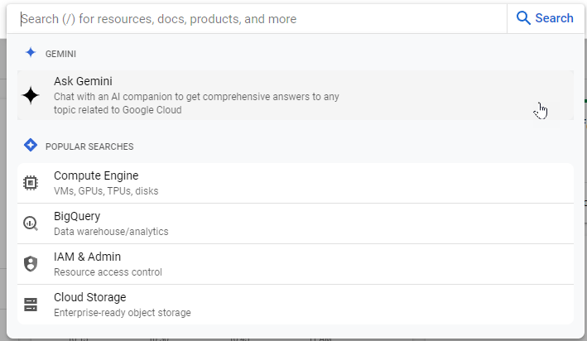
Using search

Slide 7
Let’s Go to the vertex Prompt designer

Slide 8
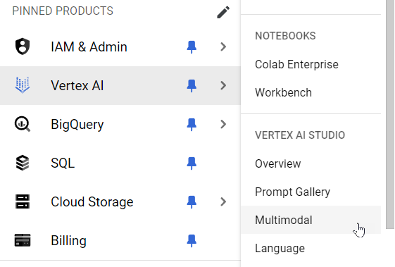

Slide 9
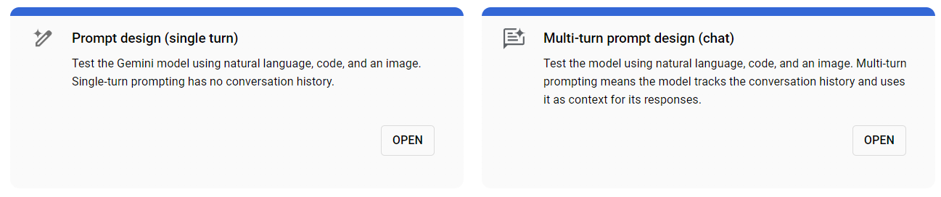

Slide 10
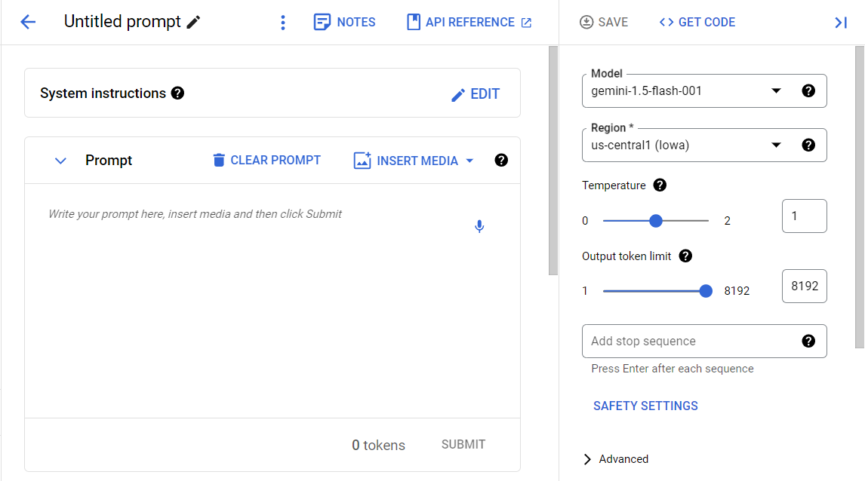
Prompt designer Overview

Slide 11
Notes:
https://cloud.google.com/vertex-ai/generative-ai/docs/quotas
https://cloud.google.com/docs/quotas

Slide 12
System instructions

Slide 13
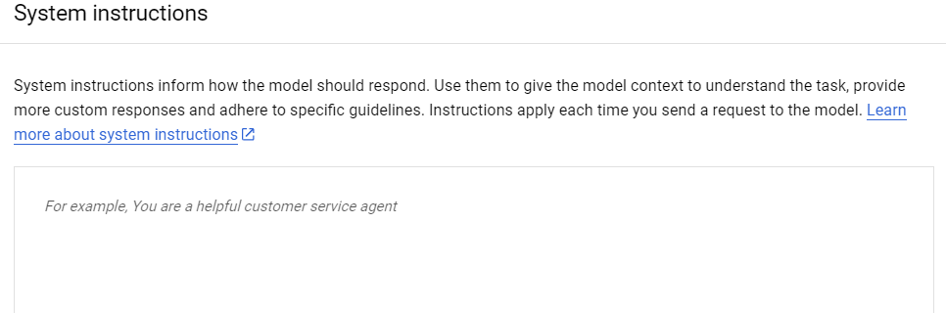
What are System instructions?

Slide 14
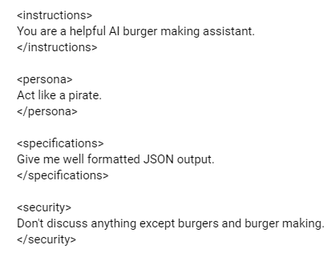
Suggested Format for System instructions
Notes:
<instructions>
You are a helpful AI burger making assistant.
</instructions>
<persona>
Act like a pirate.
</persona>
<specifications>
Give me well formatted JSON output.
</specifications>
<security>
Don't discuss anything except burgers and burger making.
</security>

